Slide 1
Project Module 2 Features extraction
Bahnisikha DUTTA
Mathieu LAPEYRE
Palash Shastri
ECE6780
Spring 2016, Professor May D. Wang

Slide 2



Team structure
Team Members
Mathieu LAPEYRE
Palash Shastri
Bahnisikha Dutta
2nd year MS (ECE)
Georgia Tech
2nd year MS (ECE)
Georgia Tech
2nd year BioE PhD(ECE)
CRAB Lab, Georgia Tech
Notes:
Guys fill in your specs

Slide 3
Objective
Ultimate Goal: Automatic Cancer Image Classification
Intermediary Goals(Module 2) :
Feature Extraction
Feature Selection
Dimensionality Reduction
Visualization

Slide 4
Workflow Diagram
Literature Review
Feature Extraction
Color Based
Texture Based
Shape Based
Feature Selection
Statistical
Dependency Ranking
Mutual Information
Dimensionality Reduction
PCNA
TSNE
Literature Review,
Color Feature Extraction,
Feature Selection
Literature Review,
Shape Feature Extraction,
Feature Selection
Literature Review,
Texture Feature Extraction,
Dimensionality Reduction

Slide 5
literature critique
 | Strategies | Papers | Location/Time | Strength/Weakness | Selected
Color Features | Histograms bins in r,g and b channels | Gurcan et al Tabesh et al | IEEE Rev Biomed Eng, vol. 2, pp. 147-171, 2009 IEEE Transactions on Medical Imaging, vol. 26, pp. 1366-1378, 2007 | Batch Dependent | Color histograms in three color spaces: rgb,lab and hsv.
Shape Features | 8 statistics based shape feature vector distribution estimation | L. Bucheron (Phd Thesis) Gurcan et al | Phd Thesis, University of California, Santa Barabara, 2008 IEEE Rev Biomed Eng, vol. 2, pp. 147-171, 2009 | Effectively covers the important geometric statistics that enable unique identification of shapes Only an approximation of the distribution and not exact | 11 features- Area, Major Axis, Minor Axis, Eccentricity, Convex Area, Filled Area, Euler Number, Orientation, Solidity, Perimeter, Extent
Texture Features | GLCM GLRL Wavelet Fractal | Gurcan et al, R. M. Haralick et al Livens et al. | IEEE Rev Biomed Eng, vol. 2, pp. 147-171, 2009 Classification, IEEE Transactions on Systems, Nov. 1973 University of Antwerp, Belgium, 1997 | GLCM is fast and widely used. Wavelet and fractal are new but promising compared to Gabor (but can be computationally expensive). There was no significant amount of information for GLRL. | GLCM
Notes:
Split the table into 2 slides if reqd
Explain what exists, what is lacking, by who and when
+ one summary table to summarize literature critique to assess strength/weakness of methods
WHAT you researched and learned, and WHY you picked up these methods

Slide 6
literature critique
 | Strategies | Papers | Location | Strength/Weakness | Selected
Feature Selection | SD SFS/SBS SFFS MI | Gurcan et al | IEEE Rev Biomed Eng, vol. 2, pp. 147-171, 2009 | Provides an overview of various feature selection techniques used in the literature SD and MI feature ranking techniques are very efficient and effective implementations | SD MI
Dimensionality Reduction | PCNA TSNE ICA LLE | Gurcan et al Roweis et al Van Der Maaten | IEEE Rev Biomed Eng, vol. 2, pp. 147-171, 2009 Science 290, 2000 Journal of Machine Learning Research 9, 2008 | PCNA is linear and easily computable TSNE is non-linear, easy to optimize and well suited for very high-dimensional data LLE preserves the local structure of data but not the global structure | PCNA TSNE
Notes:
t-Distributed Stochastic Neighbor Embedding
Explain what exists, what is lacking, by who and when
+ one summary table to summarize literature critique to assess strength/weakness of methods
WHAT you researched and learned, and WHY you picked up these methods

Slide 7
Features extraction
Color-based extraction
Conversion to YCbCr space
Removal of white pixels by thresholding at 222 in the luminance(Y) space
Color Histograms with 16 bins in 3 color spaces:
a)RGB
b)LAB
c)HSV
Total Color Features extracted:144

Slide 8
Color Features
FEATURES | COUNT
Red Channel | 16
Green Channel | 16
Blue Channel | 16
L Channel | 16
A Channel | 16
B Channel | 16
Hue Channel | 16
Saturation Channel | 16
Value Channel | 16
Totall
144

Slide 9
Features extraction
Shape-based extraction
Shape features form the basis of low-level object understanding
Shape features gives you geometric information that is unique to that object
Extracted for each stain separately
8 different statistics calculated for each shape vector to approximate the distribution
Shape features extracted:-
Area
Major Axis
Minor Axis
Eccentricity
Orientation
Convex area
Solidity
Filled Area
Euler Number
Extent
Perimeter
Total Shape Features extracted: (88x3) = 264
Statistics calculated for each feature-
Minimum
Maximum
Mean
Median
Standard Deviation
Inter Quartile Range (IQR)
Skewness
Kurtosis

Slide 10
SHAPE FEATURES
FEATURE | COUNT
Area | 8
Major Axis | 8
Minor Axis | 8
Eccentricity | 8
Orientation | 8
Convex Area | 8
Solidity | 8
Filled Area | 8
Euler Number | 8
Extent | 8
Perimeter | 8

Slide 11

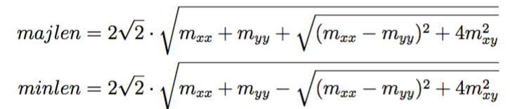
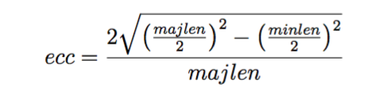
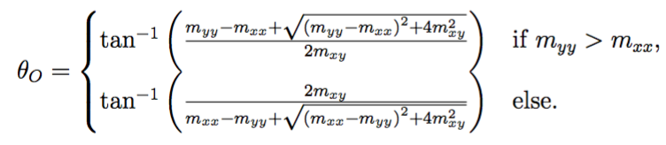




Features extraction
Shape-based extraction
Where omega(n,m) is the object mask, mxx and myy indicate second moments of x and y
Mathematical formulation of shape features-
Area -
Major Axis -
Minor Axis -
Eccentricity -
Orientation -
Convex area -
Solidity -
Filled Area -
Euler Number –

Slide 12

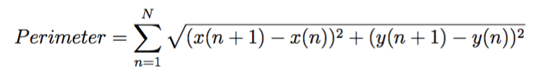
Features extraction
Shape-based extraction
Mathematical formulation of shape features-
10. Extent -
11. Perimeter -

Slide 13
Features extraction
Texture-based extraction
Easily computable textural features based on gray tone spatial dependencies
Image quantized to 64-level grayscale
Applied to stained images
Computed with different displacement and orientation values.
[1]: R. M. Haralick et al., Textural Features of Image Classification, IEEE Transactions on Systems, Nov. 1973
[2]: L. Soh and C. Tsatsoulis, Texture Analysis of SAR Sea Ice Imagery Using Gray Level Co-Occurrence Matrices, IEEE Transactions on Geoscience, March 1999.
[3]: A. Clausi, An analysis of co-occurrence texture statistics as a function of grey level quantization, 2002

Slide 14
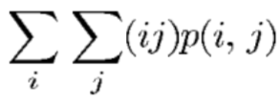




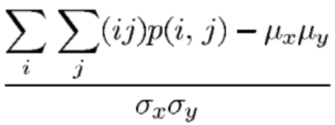
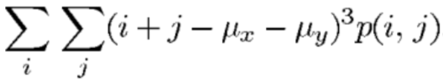


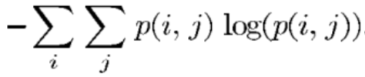


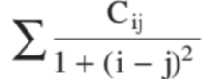
Features extraction
Autocorrelation
Contrast
Correlation
Cluster Prominence
Cluster Shade
Dissimilarity
Energy (angular second moment)
Entropy
Homogeneity
Maximum Probability
Variance
Information measure of correlation
Inverse difference
Inverse difference moment
Where , , and are respectively the mean and the standard deviation of the rows and columns of the matrix p(i,j), which is the (i,j)th entry of the GLCM.

Slide 15
TEXTURE FEATURES
FEATURES | COUNT
Autocorrelation | 20
Contrast | 20
Correlation | 40
Cluster Prominence | 20
Cluster Shade | 20
Dissimilarity | 20
Energy | 20
Entropy | 20
Homogeneity | 40
Maximum probability | 20
Sum (variance, average, …) | 60
Difference (variance, entropy, …) | 40
Information measure of correlation | 40
Inverse difference moment | 60
Totall
440

Slide 16

Features selection
Statistical Dependency(SD)
Measures dependency between features and the associated class labels
Larger the SD, more the dependency
Thresholding on the ranked features based on the SD weights
Followed by PCA

Slide 17

Features selection
Mutual Information/MI
Measures how much information the presence/absence of a term contributes to making the correct classification decision
Features ranked in descending order based on their mutuality
Above formulation shows an example for two random variables
Followed by PCA and t-SNE

Slide 18
Dimensionality reduction
Two methods :
Principle Component Analysis (PCA)
Linear algorithm
Parameter free
t-Distributed Stochastic Neighbor Embedding
Non-linear machine learning algorithm
Relies on parameters (perplexity, early exaggeration, learning rate, number of iterations)
Particularly well-suited for high-dimensional dataset
Notes:
t-Distributed Stochastic Neighbor Embedding

Slide 19
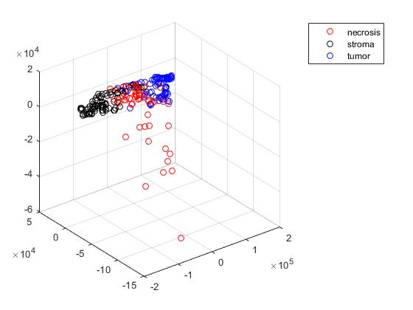
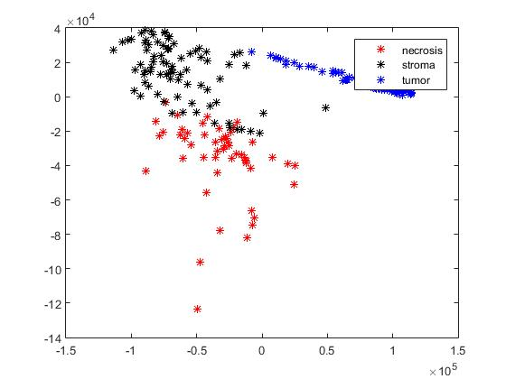
Results
SD Followed by PCNA
Scatter Plots of Dataset1(unsupervised)

Slide 20
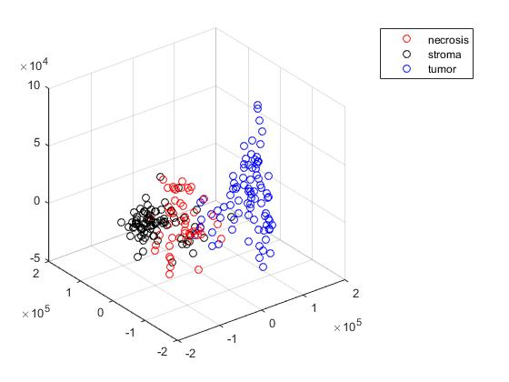
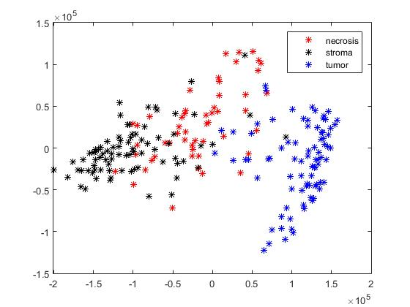
Results
SD Followed by PCNA
Scatter Plots of Dataset1(Supervised)

Slide 21
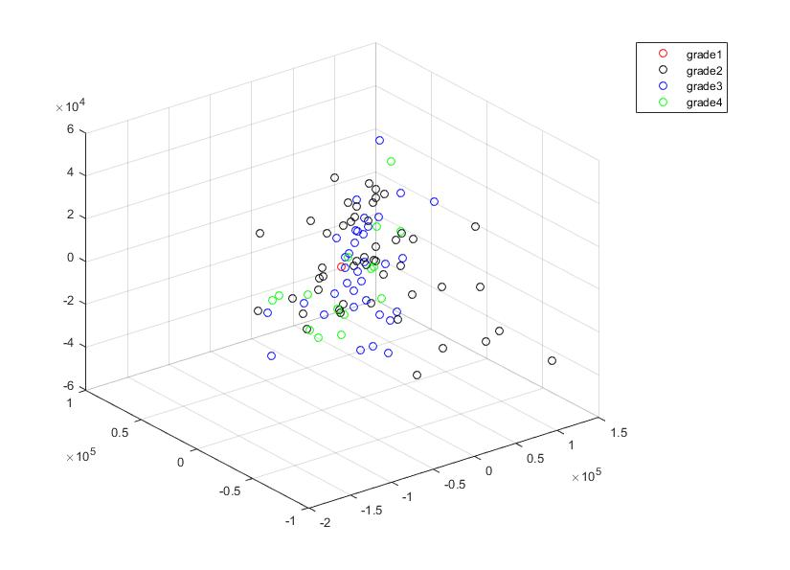
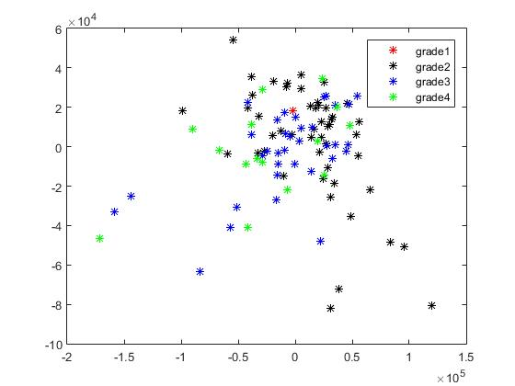
Results
SD Followed by PCNA
Scatter Plots of Dataset2(Unsupervised)

Slide 22
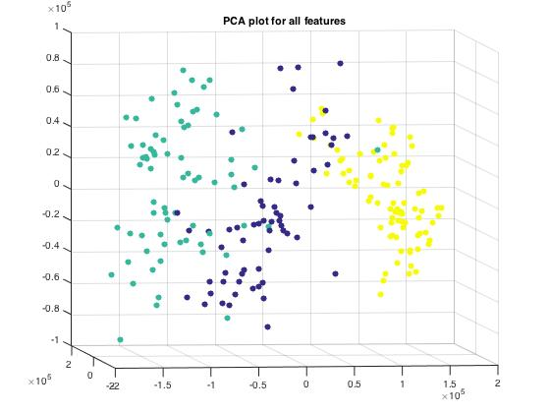
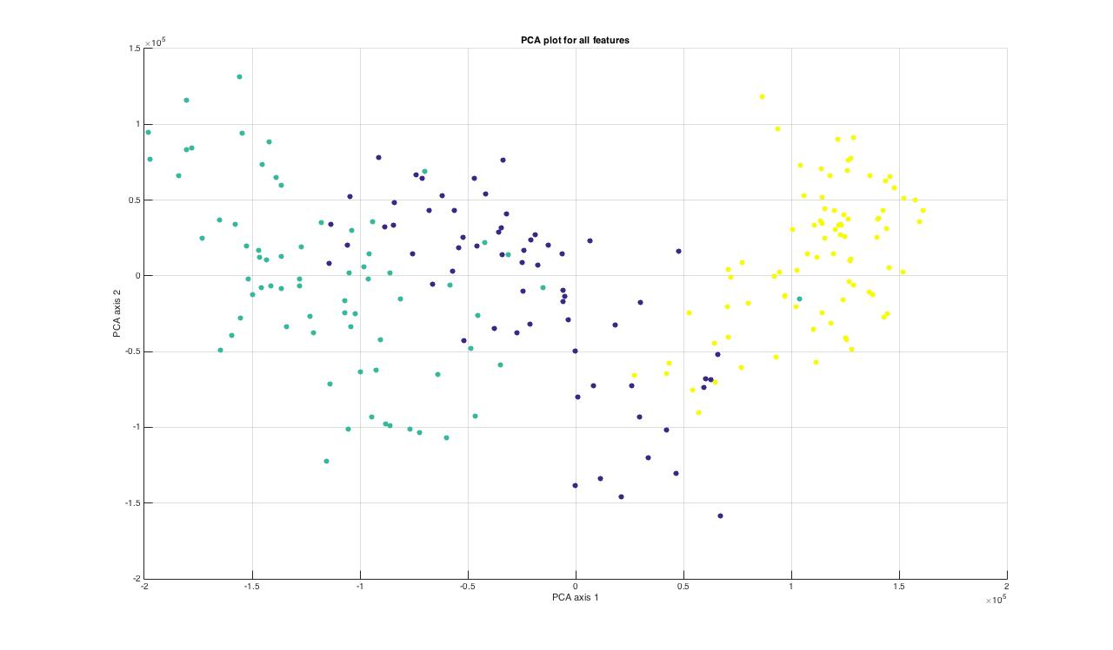
Results
MI Followed by PCA
2-D visualization
3-D visualization
Scatter Plots of Dataset1(Unsupervised)

Slide 23
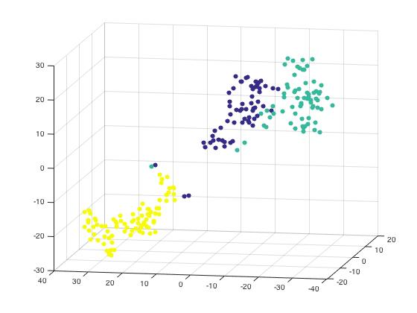
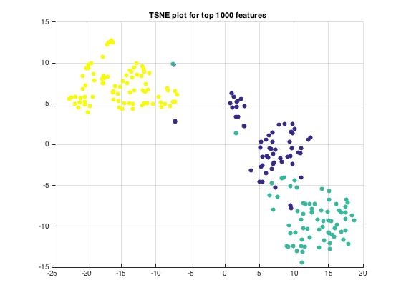
Results
MI Followed by TSNE for top 1000 features
2-D visualization
3-D visualization
Scatter Plots of Dataset1(Unsupervised)

Slide 24
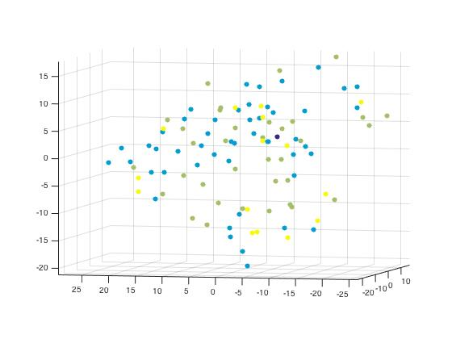
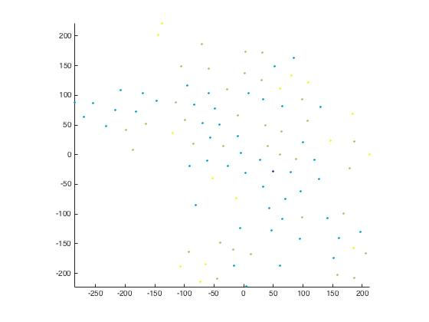
Results
MI Followed by TSNE
2-D visualization
3-D visualization
Scatter Plots of Dataset2(Unsupervised)

Slide 25
Strength/Limitations
Strength
All our implementations are comparatively fast
Subjective Selection of features
Limitation
Dataset 2 and 3 are ambiguous so it is difficult to classify
Functions | Speed
Color Features | ~0.5features/sec
Shape Features | ~2images/sec
Texture Features | ~0.4images/sec
Statistical Dependency Ranking | 0.007sec
Mutual Information | 0.010sec
PCNA | 1sec
TSNE | 10sec

Slide 26

THANKS
Any questions?

